Slide 1
MATHEMATICS Algebraic Expressions
Class:VII

Slide 2
What we will learn……
Definitions
Terms
Types
Multiplication of Algebric expression
Methods of Multiply
Factorisation terms
Merhods to factories

Slide 3
What do you mean by Algebraic Expressions?
In mathematics, an algebraic expression is an expression built up from integer constants, variables, and the algebraic operations (addition, subtraction, multiplication, division and exponentiation by an exponent that is a rational number).^{[1]} For example, 3x² − 2xy + c is an algebraic expression.

Slide 4
Examples and non example of algebraic Expressions
Examples:
4x. +7y-10
5xy- 3x+17
20 x+4z+18
Non example :
x + y=10
x²+y=15
√x+√y=0

Slide 5
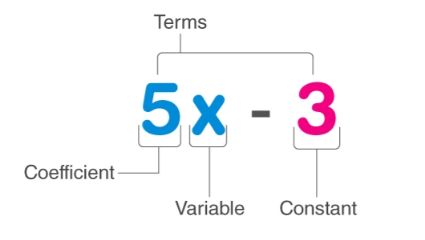
The terminology used in Algebraic expressions:
In Algebra we work with Variable, Symbols or Letters whose value is unknown to us.

Slide 6
In the above expression (i.e. 5x – 3),
x is a Variable, whose value is unknown to us which can take any value.
5 is known as the Coefficient of x, as it is a constant value used with the variable term and is well defined.
3 is the Constant value term which has a definite value.
The whole expression is known to be the Binomial term, as it has two unlikely terms.

Slide 7
Types of Algebraic expression:
There are 3 main types of algebraic expressions which include:
Monomial Expression
Binomial Expression
Polynomial Expression

Slide 8
Monomial Expression
An algebraic expression which is having only one term is known as a monomial.
Examples of monomial expression include
3x⁴, 3xy, 5z,10 xz etc.

Slide 9
Binomial Expression
A binomial expression is an algebraic expression which is having two unlikely terms.
Examples of binomial include
5xy + 8, xyz + x³, 3xy+ 7z etc.

Slide 10
Polynomial Expression
In general, an expression with more than one terms with non-negative integral exponents of a variable is known as a polynomial.
Examples of polynomial expression include
ab + bc + ca, 3x+ 4y + xy etc.

Slide 11
Multiplication of Monomial by Monomial
Let's multiply the following 2 monomials: (5x )(3x²y)
Step 1Group variables by exponent and group the coefficients (apply commutative property of multiplication)
(5 • 3)(x • x²)(y)
Step 2Multiply each like term (remember your exponents laws
(5 • 3)(x • x²)(y)=(15)( x⁽²⁺¹⁾)(y)
15x³y

Slide 12
Multiplication of Monomial by Binomial
Write in the multiplication expression and we get: 2a (3a - 4) Use Distributive Law and multiply monomial with every term of binomial & this is done in the following steps: = (2a X 3a) - (2a X 4) = 6a² - 8a Hence, 2a (3a - 4) = 6a² - 8a

Slide 13
Multiplication of Binomial with a Binomial
There are many methods to multiply 2binomials.
FOIL is one of the method
Just take one example
Multiply First Outer Inner Last. • Add your results. • Combine like terms. • Remember that this method has limited usage (binomials only).

Slide 15
What "FOIL" stands for
"Foil" is a way that people remember the 'formula' for multiplying binomials . (An alternative approach is to use "a href="/properties/double-distributive-property.php">double distributive").
FOIL stands for first, outer, inner and last pairs. You are supposed to multiply these pairs as shown below!
Firsts:
x⋅x=x2
Outers:
x⋅9=9x
Inners:
7⋅x=7x
Lasts:
7⋅9=63

Slide 16
Multiplication a Trinomial and a Binomial
Process

Slide 17
Factorisation of Polynomials
Factoring polynomials involves breaking up a polynomial into simpler terms (the factors) such that when the terms are multiplied together they equal the original polynomial. Factoring helps solve complex equations so they are easier to work with. Factoring polynomials includes: Finding the greatest common factor.

Slide 18
Examples of Factoring polynomials
We have to find out the greatest common factor, of the given polynomial to factorise it. This process is nothing but a type of reverse procedure of distributive law, such as;
p( q + r) = pq + pr
But in the case of factorisation, it is just an inverse process;
pq + pr = p(q + r)
where p is the greatest common factor

Slide 19
Factorise x²-15x+50
Find the two numbers which when added gives -15 and when multiplied gives 50.
So, -5 and -10 are the two numbers, such that;
(-5) + (-10) = -15
(-5) x (-10) = 50
Hence, we can write the given polynomial as;
x²-5x-10x+50
x(x-5)-10(x-5)
Taking x – 5 as common factor we get;
(x-5)(x-10)( so, solutions for the answer is this)

Slide 20
Work sheet:
Factorise the following:
a²+8a+16
x ² -ax-bx+ab
1+ax+ab+x

Slide 21
What we know from the chapter:

